Slide 1
DISTRICT GIS · PARAKH
Indore Division Inspection Monitoring
Implementation Overview — mapped to the approved SOP workflow
Prepared for review · Indore Division

Slide 2
SOP REFERENCE
The Workflow
As defined in the Inspection Management Workflow SOP document
1
2
3
4
5
Login & Select
Department
Conduct
Inspection
Generate &
Sync Report
Review &
Action
Closure &
Monitoring
›
›
›
›
Inspector logs in and
selects the department
Checklist, remarks, photos
& proposed action
Digital report synced to
central server
Collector monitors;
Dept. Officer takes action
Inspection closed; Commissioner
views division dashboard
This deck presents the modules built to implement each stage of this workflow.
Inspection Management System | District GIS · PARAKH
2

Slide 3
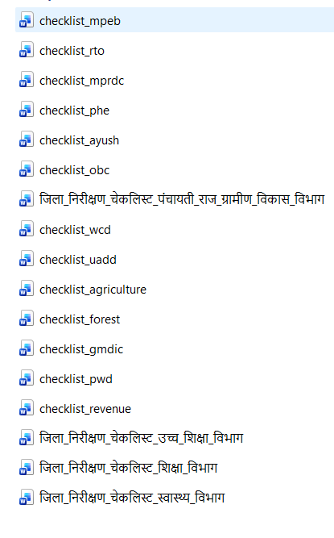
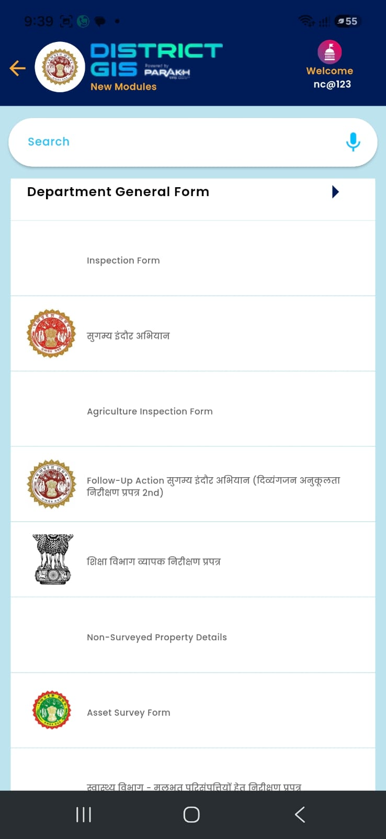
IMPLEMENTED · STEP 1–2
Department-wise Inspection Forms
Digital checklists in the District GIS Parakh mobile application
Each department gets its own inspection checklist form inside the District GIS Parakh mobile app. (Work In Progress – Forms)
Forms cover multiple domains — Education, Agriculture, Health, PNRD, UADD, and more.
Inspector selects the department, institution type, and fills the structured checklist on-site.
Supports dropdowns, remarks/suggestions, and photo/document capture per field.
Directly maps to SOP steps: Select Department → Conduct Inspection.
Inspection Management System | District GIS · PARAKH
3

Slide 4
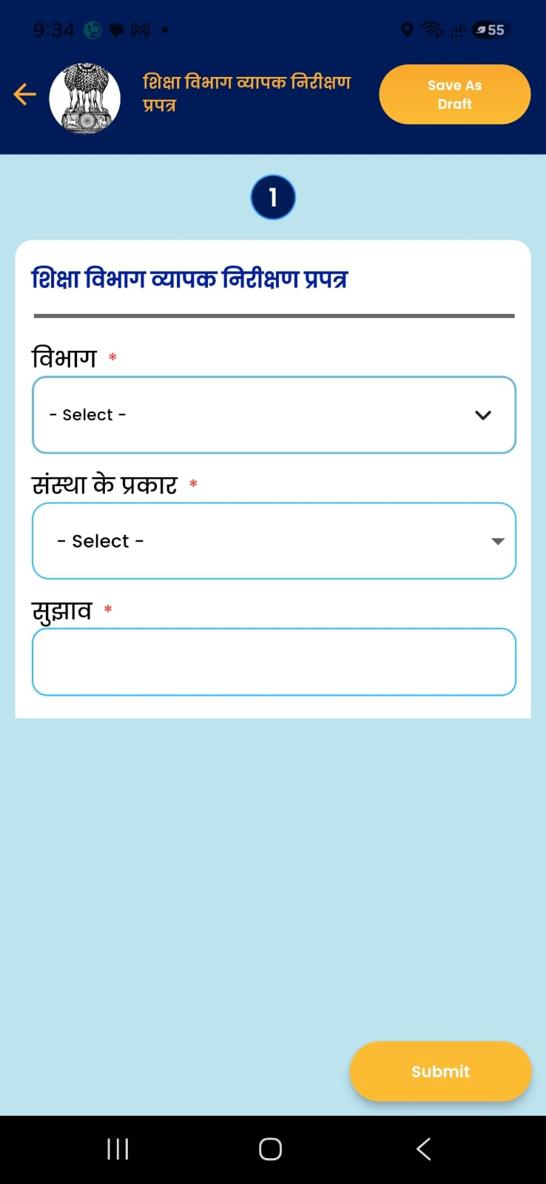
IMPLEMENTATION IN PROGRESS · STEP 2
Structured Checklist Capture
Example: Education Department comprehensive inspection form
Form fields are department-specific: विभाग (Department), संस्था के प्रकार (Institution Type), सुझाव (Suggestions).
Dropdown-driven, mandatory-field validation (marked with *).
'Save As Draft' lets inspectors resume incomplete inspections.
'Submit' pushes the record to the central PARAKH server for reporting.
Inspection Management System | District GIS · PARAKH
4

Slide 5
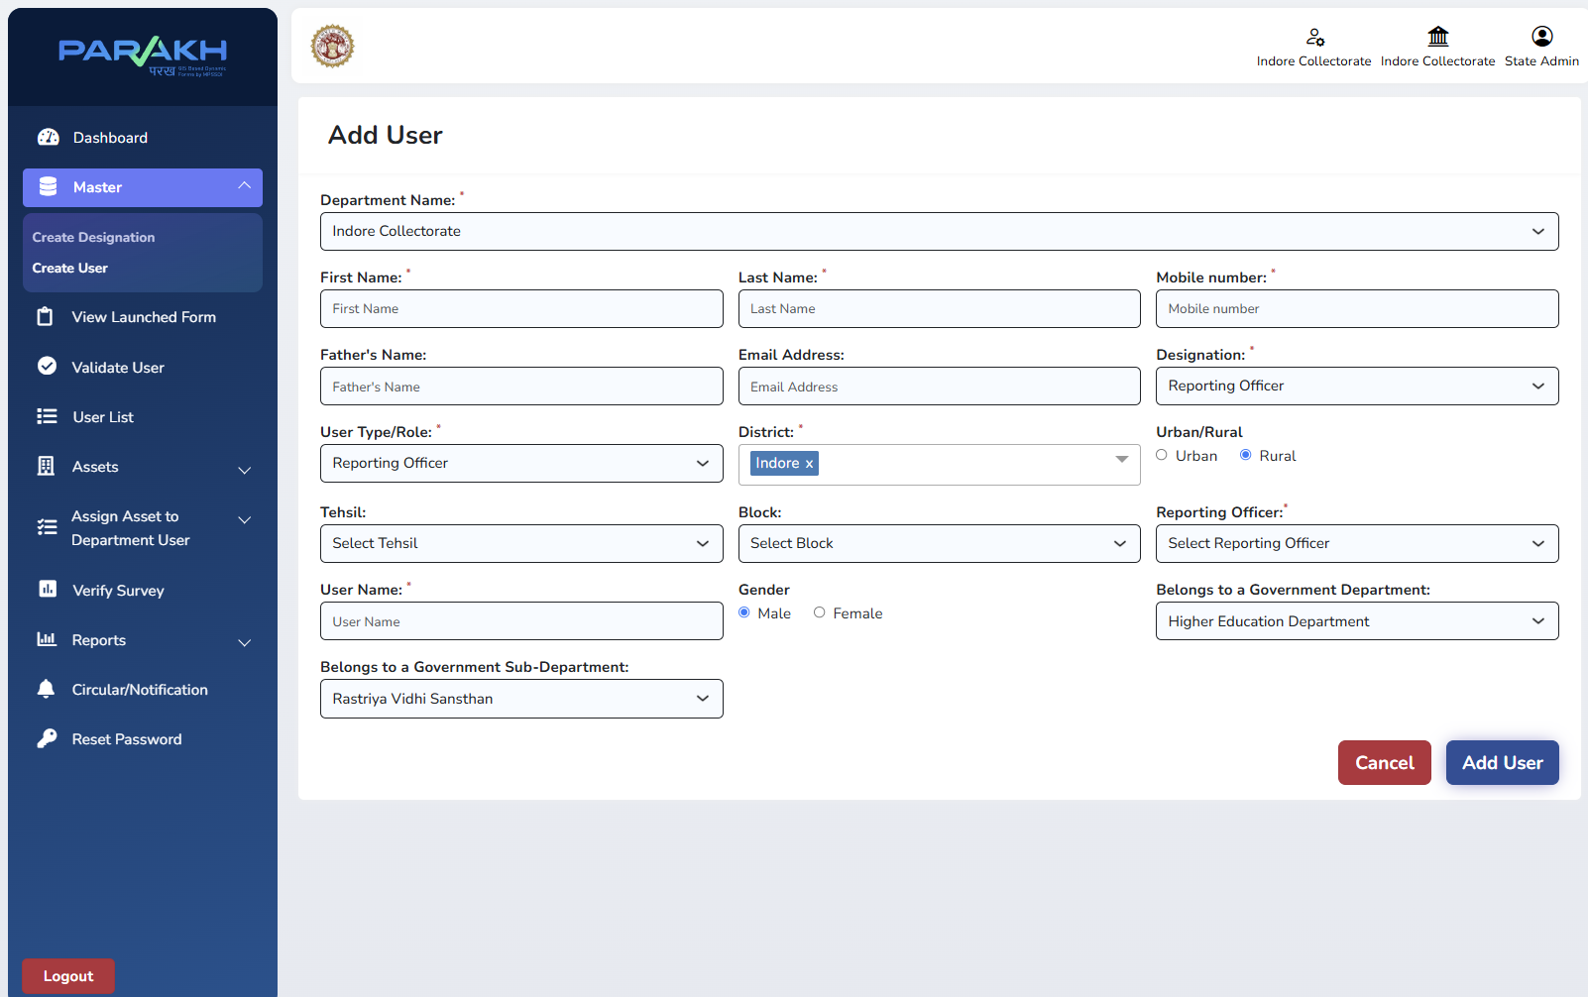
IMPLEMENTED · ACTOR SETUP
RO User Created as Department HOD
Reporting Officer mapped to Department & Sub-Department in PARAKH Master
User Type/Role set to 'Reporting Officer' — acting as HOD for the linked department.
'Belongs to a Government Department' and 'Sub-Department' fields tie the RO - HOD to a specific unit (e.g. Higher Education Dept.).
District, Tehsil, Block and Urban/Rural scope define the RO's jurisdiction.
This RO becomes the approving & raise action authority for inspections raised under that department.
Inspection Management System | District GIS · PARAKH
5

Slide 6
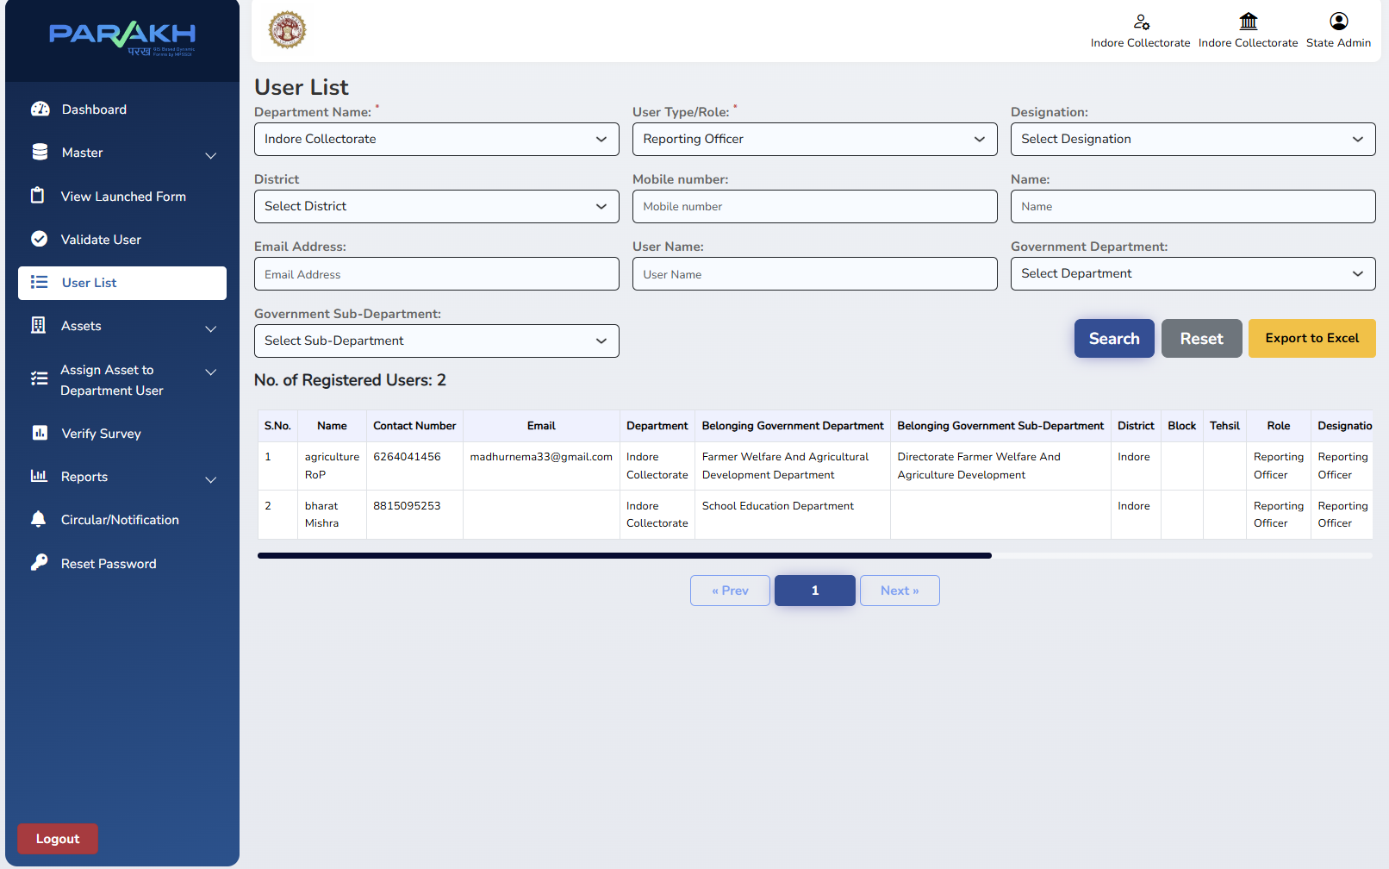
IMPLEMENTED · VERIFICATION
Department HODs Visible in User List
Admin can search, verify and export all Reporting Officers created
Every RO/HOD created shows Department, Sub-Department, District/Block/Tehsil and Role.
Filterable by Department, Role, Designation for quick audit.
'Export to Excel' supports offline record-keeping.
Confirms each department has its own accountable HOD before inspections go live.
Inspection Management System | District GIS · PARAKH
6

Slide 7
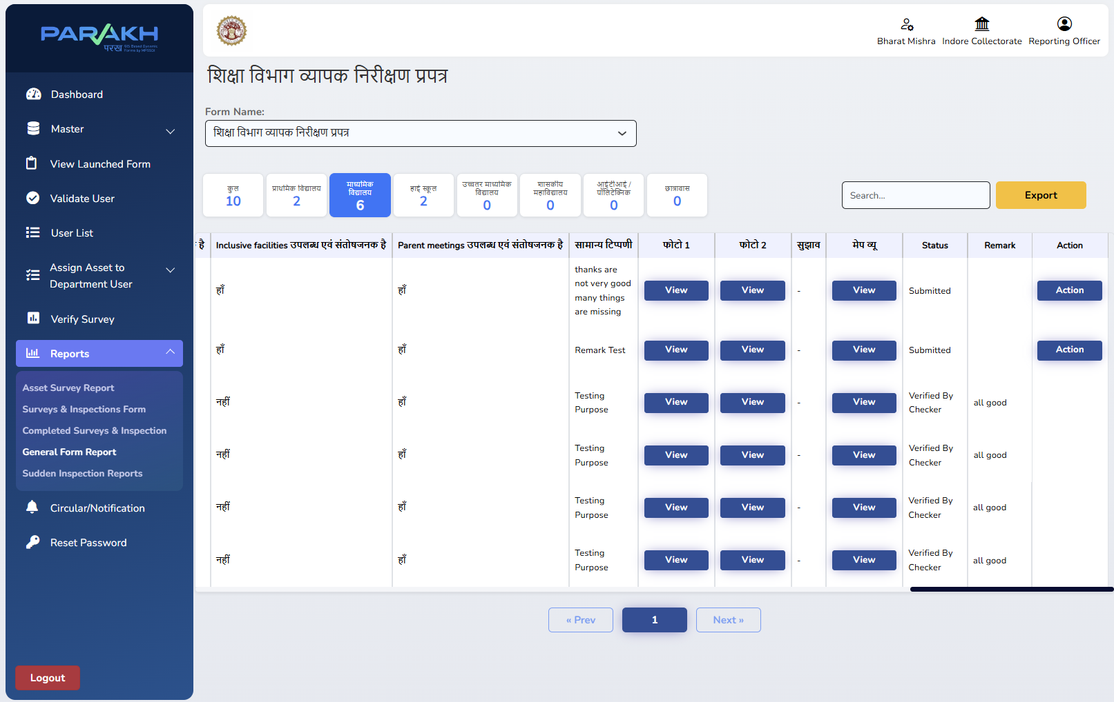
IMPLEMENTED · STEP 3–4
General Form Report — Reviewed & Actioned by HOD
Department HOD (RO) views submissions and takes action in one screen
HOD logs in as Reporting Officer, scoped to their own department.
Reports → General Form Report lists every submitted inspection with photos, remarks & status.
'Action' button lets the HOD Verify / Reject / Remark on each record.
Status updates flow back — matching SOP's 'District Department Officer: Review & Necessary Action'.
Inspection Management System | District GIS · PARAKH
7

Slide 8
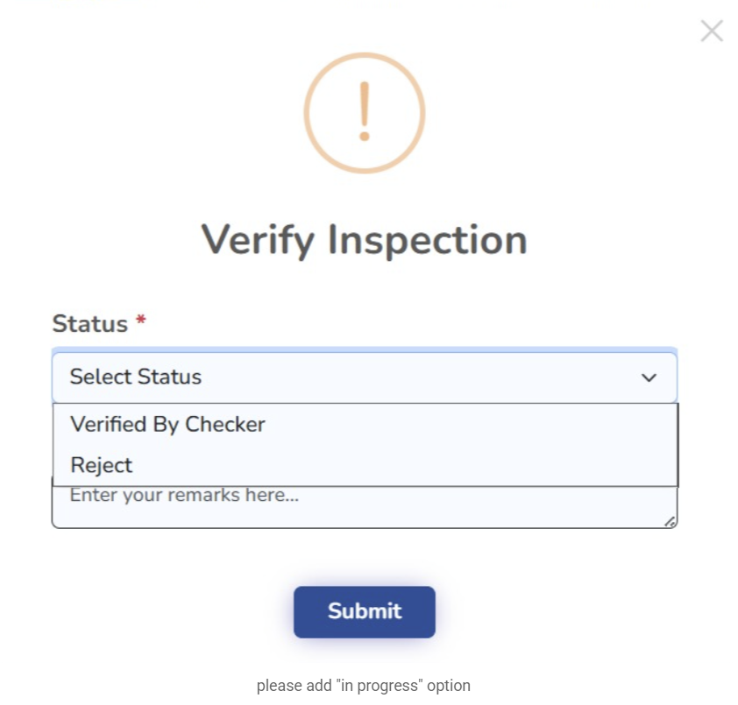
IMPLEMENTED · STEP 3–4
General Form Report — Reviewed & Actioned by HOD
Department HOD (RO) views submissions and takes action in one screen - Action Button Verify Inspection Status Verified by checker Reject and IN Progress or Pending
HOD logs in as Reporting Officer, scoped to their own department.
Reports → General Form Report lists every submitted inspection with photos, remarks & status.
'Action' button lets the HOD Verify / Reject / Remark on each record.
Status updates flow back — matching SOP's 'District Department Officer: Review & Necessary Action'.
Inspection Management System | District GIS · PARAKH
7

Slide 9
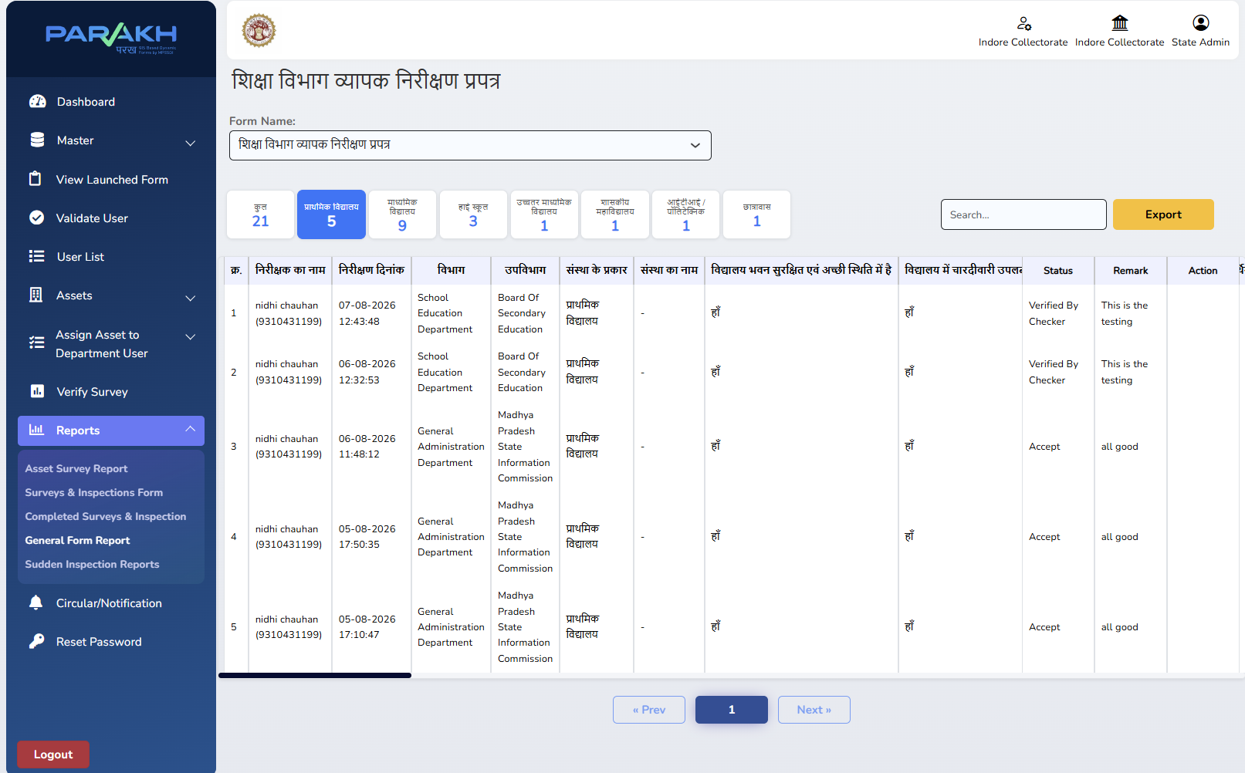
IMPLEMENTED · STEP 4 (MONITORING)
Report Visible to Collector Sir's ID
Same General Form Report, viewed under the State Admin / Collector login
Collector's ID has district-level access across all departments and forms.
Same report screen (General Form Report) — filterable by institution type, with status and remarks.
Gives the Collector a consolidated, real-time monitoring view without waiting for offline compilation.
Fulfils SOP's 'District Collector — Monitoring' role.
Inspection Management System | District GIS · PARAKH
8

Slide 10
IN PROGRESS · FINAL STEP
Division-Level Review & Commissioner Dashboard
View-only dashboard for Divisional Commissioner Sir — build under way, targeted for completion next week
Scope of this module
Aggregated, division-wide view of inspection data pulled in from every district under the division
Read-only login being provisioned for the Divisional Commissioner Sir
Compliance & status analytics, sliceable by district, department and inspection status
Filters for department, district, date range and inspection status
Fulfils SOP's final step — "Divisional Commissioner: View Dashboard & Division Monitoring"
Target completion: next week.
Dashboard build and division-level data rollup are currently in progress.
Will give Commissioner Sir a consolidated, real-time view across the full division.
Fulfils SOP's final 'Divisional Commissioner' review step.
Inspection Management System | District GIS · PARAKH
9

Slide 11
SUMMARY
SOP Requirement → What's Built
Each control point in the approved workflow now has a working module
SOP WORKFLOW STEP
IMPLEMENTATION
Select Department & Conduct Inspection (Work In Progress)
Department-wise inspection forms live in District GIS mobile app
✓
Department Officer (Review & Action)
RO user created as HOD — mapped to Department & Sub-Department
✓
Generate & Sync (Report)
Submissions flow into General Form Report on PARAKH web portal
✓
District Department Officer (Takes Action)
HOD (RO) reviews & actions records from General Form Report
✓
District Collector / Divisional Commissioner (Monitoring – WIP)
Collector Sir's ID views the same report with full oversight
✓
Inspection Management System | District GIS · PARAKH
10

Slide 12
Workflow Implemented End-to-End
Department Forms → HOD (RO) Setup → General Form Report & Action → Collector Monitoring
Thank you

